Slide 1
Chapter 3 – Part 2
MEDIA ACCESS CONTROL

Slide 2
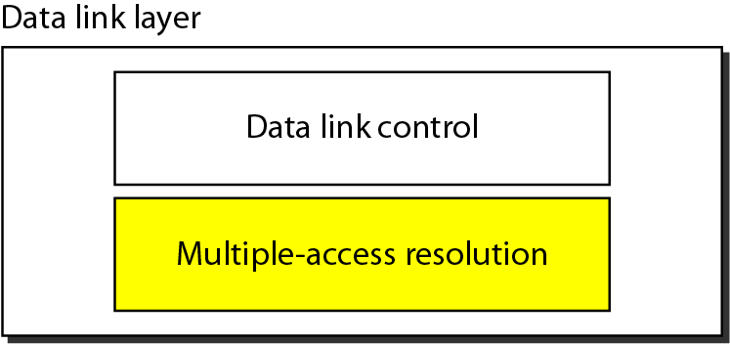
Data link layer divided into two functionality-oriented sublayers
Responsible for error and flow control
Link Layer Control (LLC)
Control
MAC
Responsible framing and MAC address and Multiple Access Control

Slide 3
Multiple Access
Problem: When two or more nodes transmit at the same time, their frames will collide and the link bandwidth is wasted during collision
How to coordinate the access of multiple sending/receiving nodes to the shared link???
Solution: We need a protocol to coordinate the transmission of the active nodes
These protocols are called Medium or Multiple Access Control (MAC) Protocols belong to a sublayer of the data link layer called MAC (Medium Access Control)
What is expected from Multiple Access Protocols:
Main task is to minimize collisions in order to utilize the bandwidth by:
Determining when a station can use the link (medium)
what a station should do when the link is busy
what the station should do when it is involved in collision

Slide 4
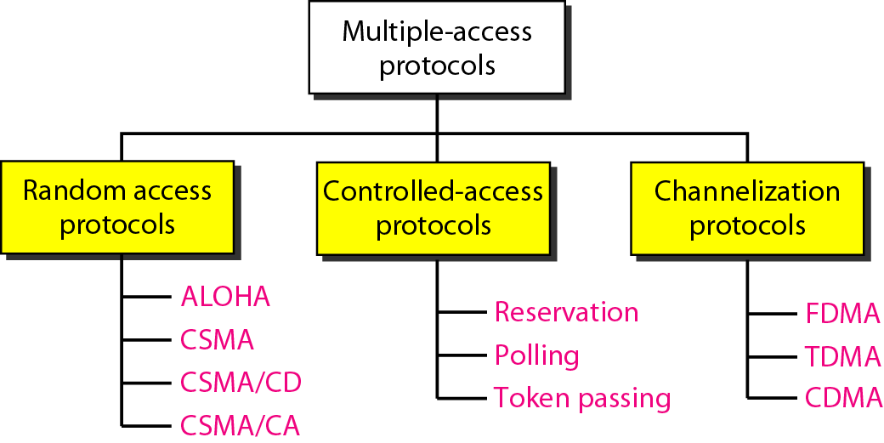
Taxonomy of multiple-access protocols

Slide 5
RANDOM ACCESS/ Contention protocol
In random access or contention methods, no station is superior to another station and none is assigned the control over another.
No station permits, or does not permit, another station to send.
At each instance, a station that has data to send uses a procedure defined by the protocol to make a decision on whether or not to send.
Two terms can be explained as follows.
Random access: because there is no schedule time defined for a station to transmit. Transmission is random among the stations.
Contention: because stations compete with each other to access the channel.

Slide 6
Four Random access protocols
ALOHA Carrier Sense Multiple Access
Carrier Sense Multiple Access with Collision Detection
Carrier Sense Multiple Access with Collision Avoidance

Slide 7
ALOHA – meaning
Was developed at the university of Hawaii in early 1970
Derived from a compound word of the Hawaiian words
ALO means “share”
Ha means “ essence of life”

Slide 8
Pure ALOHA
This is a simple and elegant protocol
Each station sends a frame whenever it has a frame to send.
However , the channel is shared among all the stations, there are chances of collision between frames from different stations.
After sending frame, the station simply wait for an ack.
If the acknowledgement does not arrive after a time-out-period expires, the station retransmits the frame.
A collision involves two or more stations. If all of them again retransmit then there will be collision again.

Slide 9
Pure ALOHA (1)
Improvement 1:
After a time-out period, wait for a random amount of time and then try again.
This randomness will help avoid more collisions.
This random time is called back-off Time. Tb
Improvement 2:
After a number of retransmissions attempts Kmax, a station must give up and try later.
Usually Kmax = 15

Slide 10
Pure ALOHA (2)
How much should be the time out period?
The time out period = maximum possible RTT
RTTmax is the twice the amount of time taken to send a frame between two farthest stations on a link.
RTT = 2 * Tp , where Tp-Propagation Delay

Slide 11
Pure ALOHA(3)
The back-off Time (Tb)
The back off time Tb is a random value that normally depends on k (no. of retransmissions).
Usually the Tb increases as number of attempts increases.

Slide 12
Pure ALOHA Protocol Description (4)
All frames from any station are of fixed length (L bits)
Stations transmit at equal transmission time (all stations produce frames with equal frame lengths).
A station that has data can transmit at any time
After transmitting a frame, the sender waits for an acknowledgment for an amount of time (time out) equal to the maximum round-trip propagation delay = 2* t_{p}
If no ACK was received, sender assumes that the frame or ACK has been destroyed and resends that frame after it waits for a random amount of time
If station fails to receive an ACK after repeated transmissions, it gives up

Slide 13
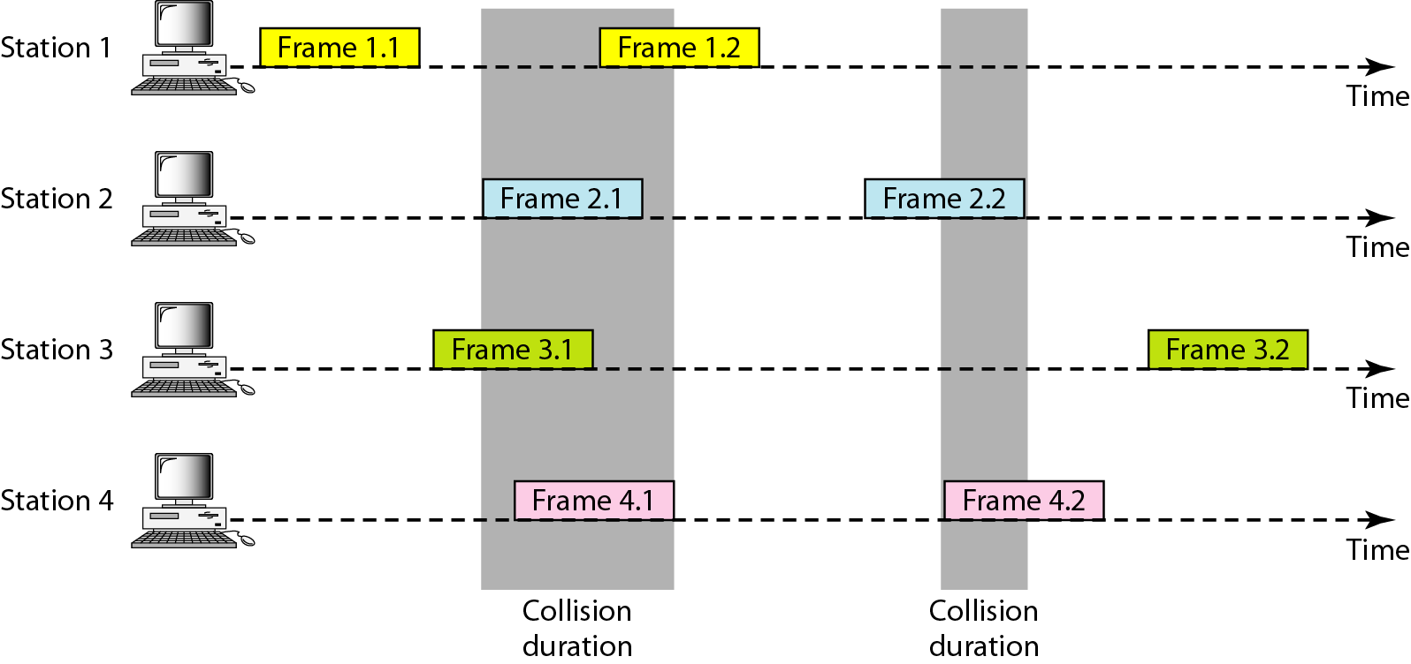
Frames in a pure ALOHA network

Slide 14
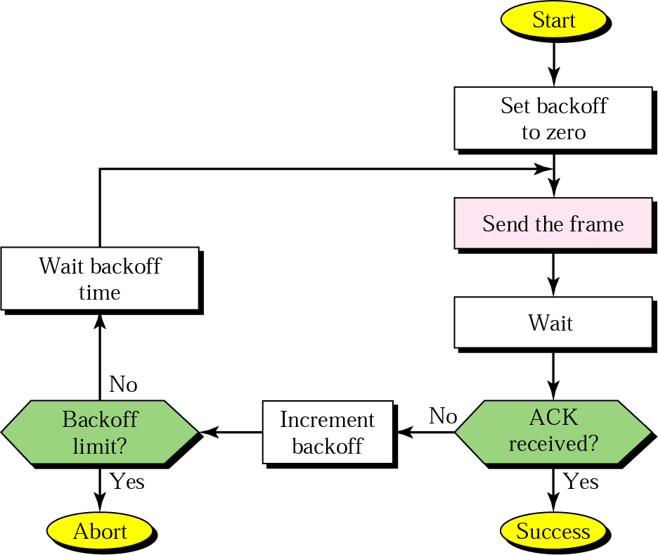
Procedure for ALOHA protocol

Slide 15
Pure ALOHA (7)
Vulnerable Time: The length of time in which there is a probability of collision.
For ALOHA
Where Tf is the average time required to transmit one frame.
Vulnerable Time = 2 * Tf

Slide 16
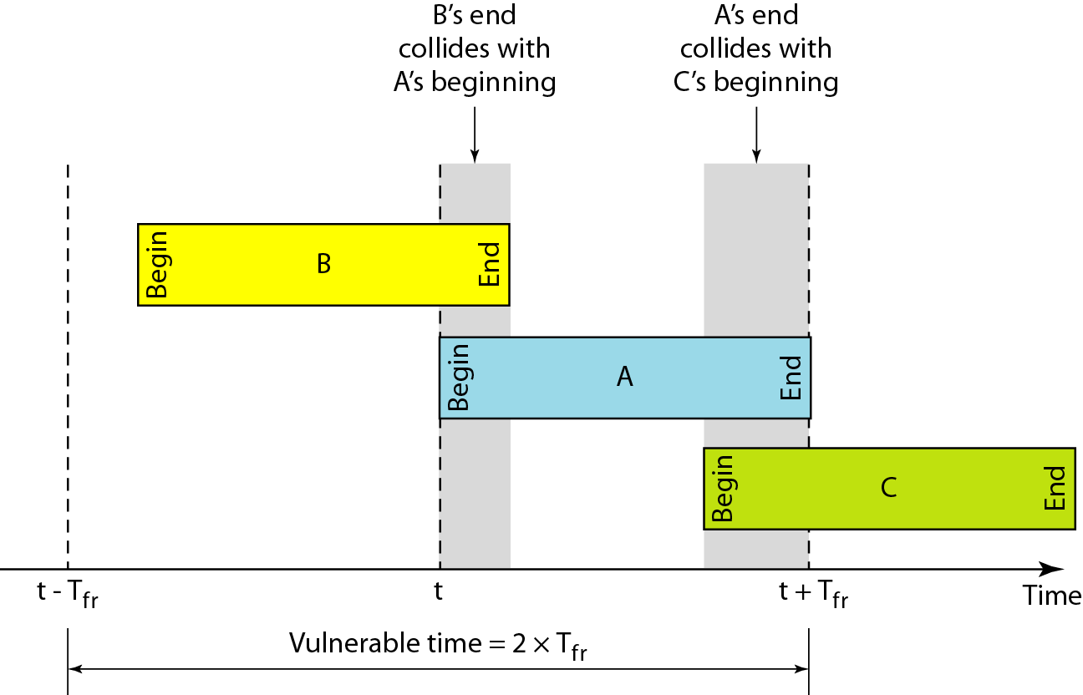
Vulnerable time for pure ALOHA protocol
If the frame transmission time is Tf sec, then the vulnerable time is = 2 * Tf sec.
This means no station should send during the T-sec before this station starts transmission and no station should start sending during the T-sec period that the current station is sending.

Slide 17
Pure ALOHA - Efficiency
Channel utilization or efficiency or Throughput is the percentage of the transmitted frames that arrive successfully (without collisions) or the percentage of the channel bandwidth that will be used for transmitting frames without collisions
ALOHA Maximum channel utilization is 18% (i.e, if the system produces F frames/s, then 0.18 * F frames will arrive successfully on average without the need of retransmission).

Slide 18
The throughput for pure ALOHA is S = G × e ^{−2G} .
The maximum throughput
S_{max} = 0.184 when G= (1/2).

Slide 19
Random Access – Slotted ALOHA
Time is divided into slots equal to a frame transmission time (Tf)
A station can transmit at the beginning of a slot only
If a station misses the beginning of a slot, it has to wait until the beginning of the next time slot.
A central clock or station informs all stations about the start of a each slot
Maximum channel utilization is 0.368% (Approx. 37%)

Slide 20
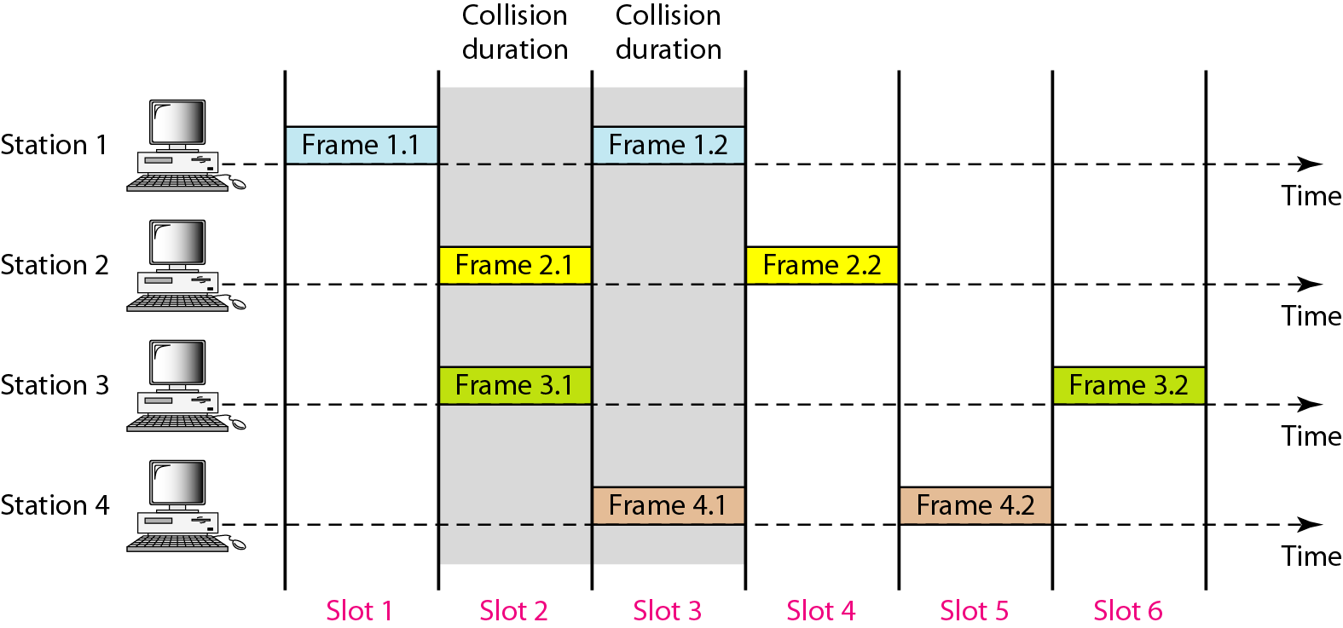
Frames in a slotted ALOHA network

Slide 21
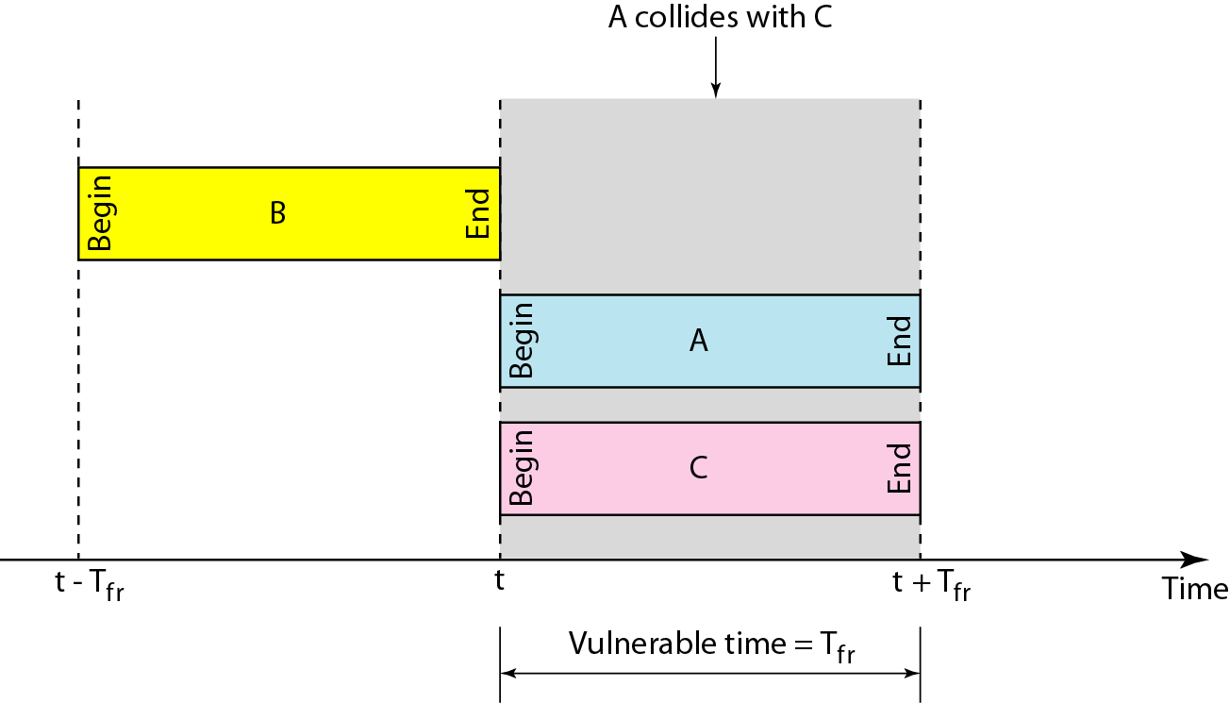
Vulnerable time for slotted ALOHA protocol

Slide 22
The throughput for slotted ALOHA is S = G × e^{−G} .
The maximum throughput S_{max} = 0.368 when G = 1.

Slide 23
Efficiency of ALOHA
0.4
0.3
S = throughput =(success rate)
Slotted Aloha
0.2
0.1
Pure Aloha
0.5
1.0
1.5
2.0
G = offered load rate= new frames+ retransmitted
= Total frames presented to the link per
the transmission time of a single frame

Slide 24
Advantage of ALOHA protocols
A node that has frames to be transmitted can transmit continuously at the full rate of channel (R bps) if it is the only node with frames
Simple to be implemented
No master station is needed to control the medium
Disadvantage
If (M) nodes want to transmit, many collisions can occur and the rate allocated for each node will not be on average R/M bps
This causes low channel utilization

Slide 25
Random Access – Carrier Sense Multiple Access (CSMA)
Each station senses the channel before sending a frame.
If the channel is busy, devices wait before transmitting.
This can reduce the possibility of collision but it cannot eliminate it.
Collision can only happen when more than one station begin transmitting within the propagation time period..

Slide 26
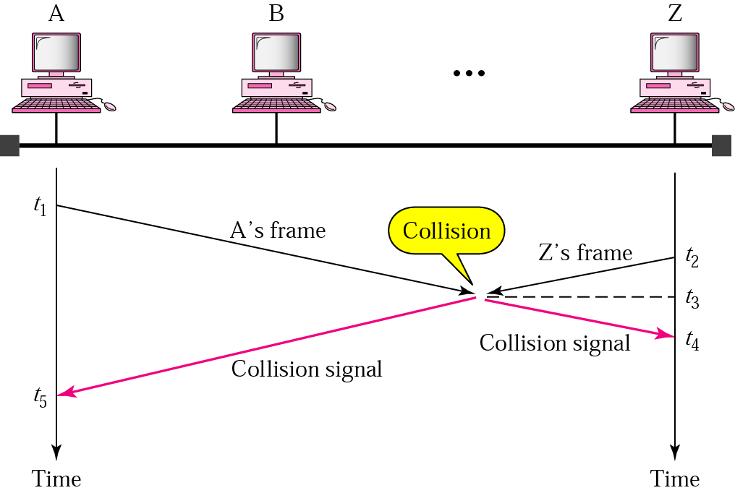
CSMA

Slide 27
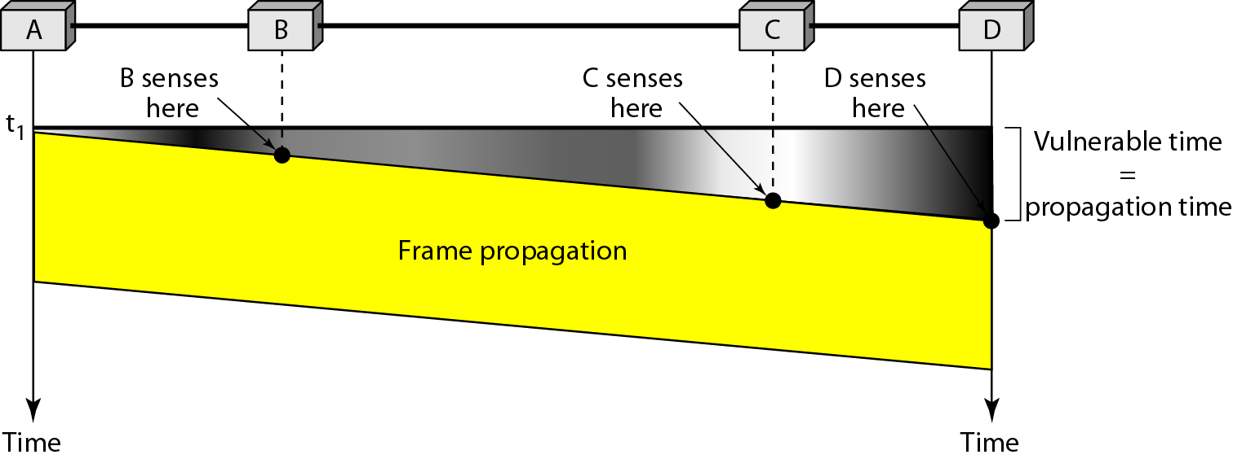
Random Access – Carrier Sense Multiple Access (CSMA)
Vulnerable time for CSMA is the maximum propagation time
The longer the propagation delay, the worse the performance of the protocol because of the above case.

Slide 28
Types of CSMA Protocols
Different CSMA protocols that determine:
What a station should do when the medium is idle?
What a station should do when the medium is busy?
Non-Persistent CSMA
1-Persistent CSMA
p-Persistent CSMA

Slide 29
1- Persistent
After a station finds the line idle, it sends the frame immediately (i,.e with probability 1).
This method has a highest chance of collisions.
Non-persistent
A station that has a frame to send senses the channel. If the line is idle , it sends immediately else it waits a random amount of time and then senses the channel again.
This approach reduces the chances of collision , because it is unlikely that two station chooses the same random time and sense the channel simultaneously.
P-Persistent
It is used if the channel is divided into time slot equal to maximum Tp or more than Tp.
It combines the advantages of above two methods.
In this method, after the station finds the channel idle it transmits with a probability p.
With probability q=1-p it differs until the next slot. If that slot is also idle, it either transmits or differs again, with probability p and q. This process is repeated until the station sends the frame or other station has begun transmission.

Slide 30
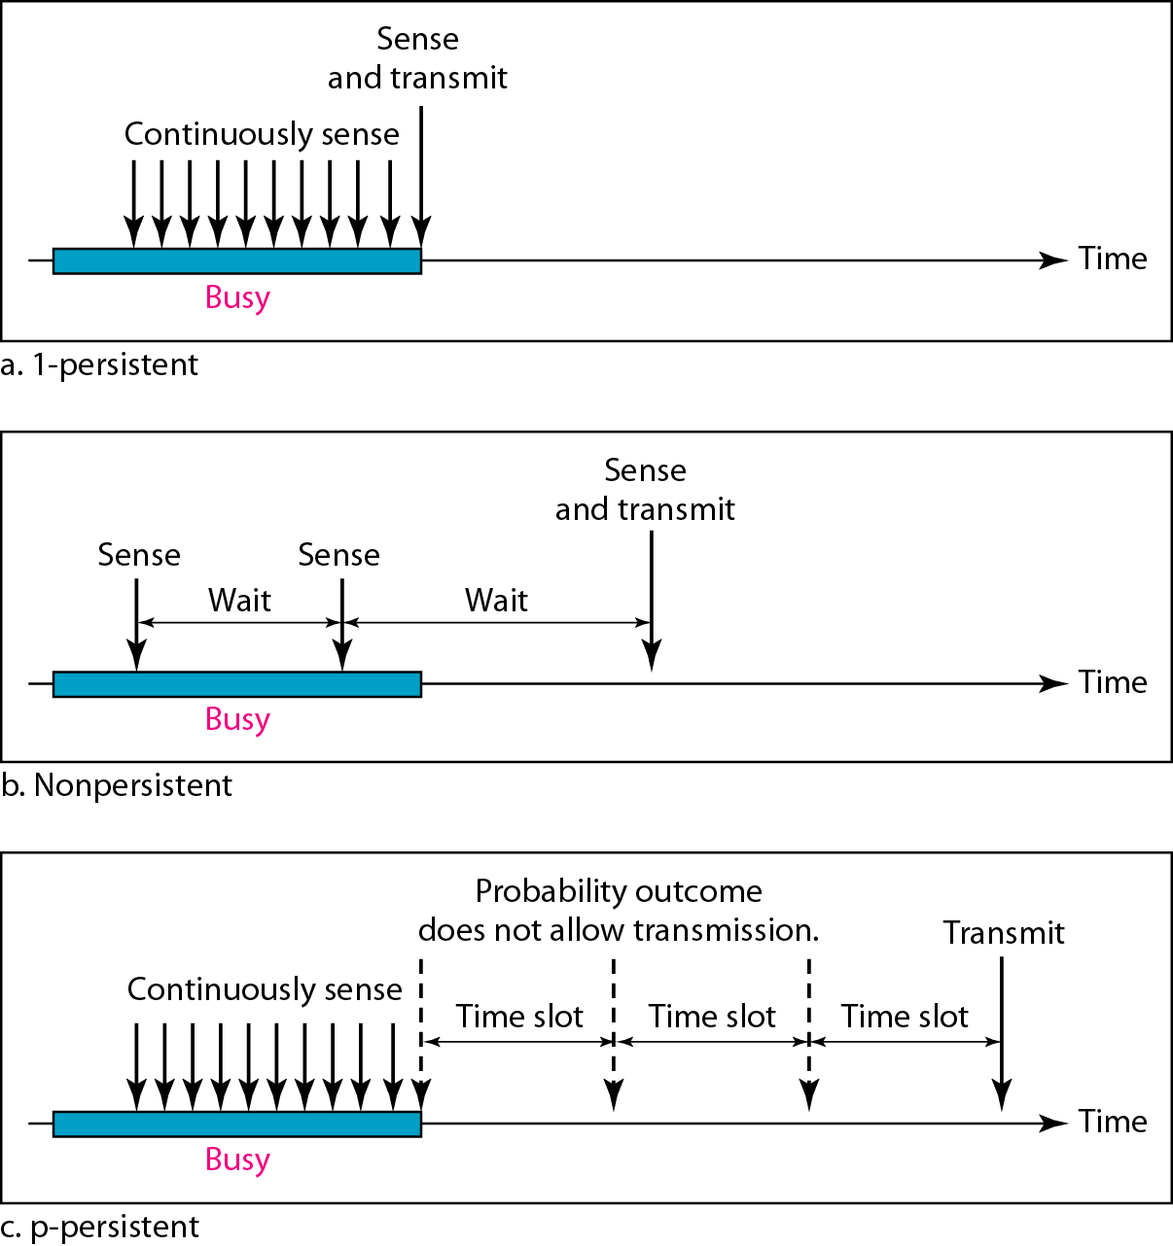
Behavior of three persistence methods

Slide 31
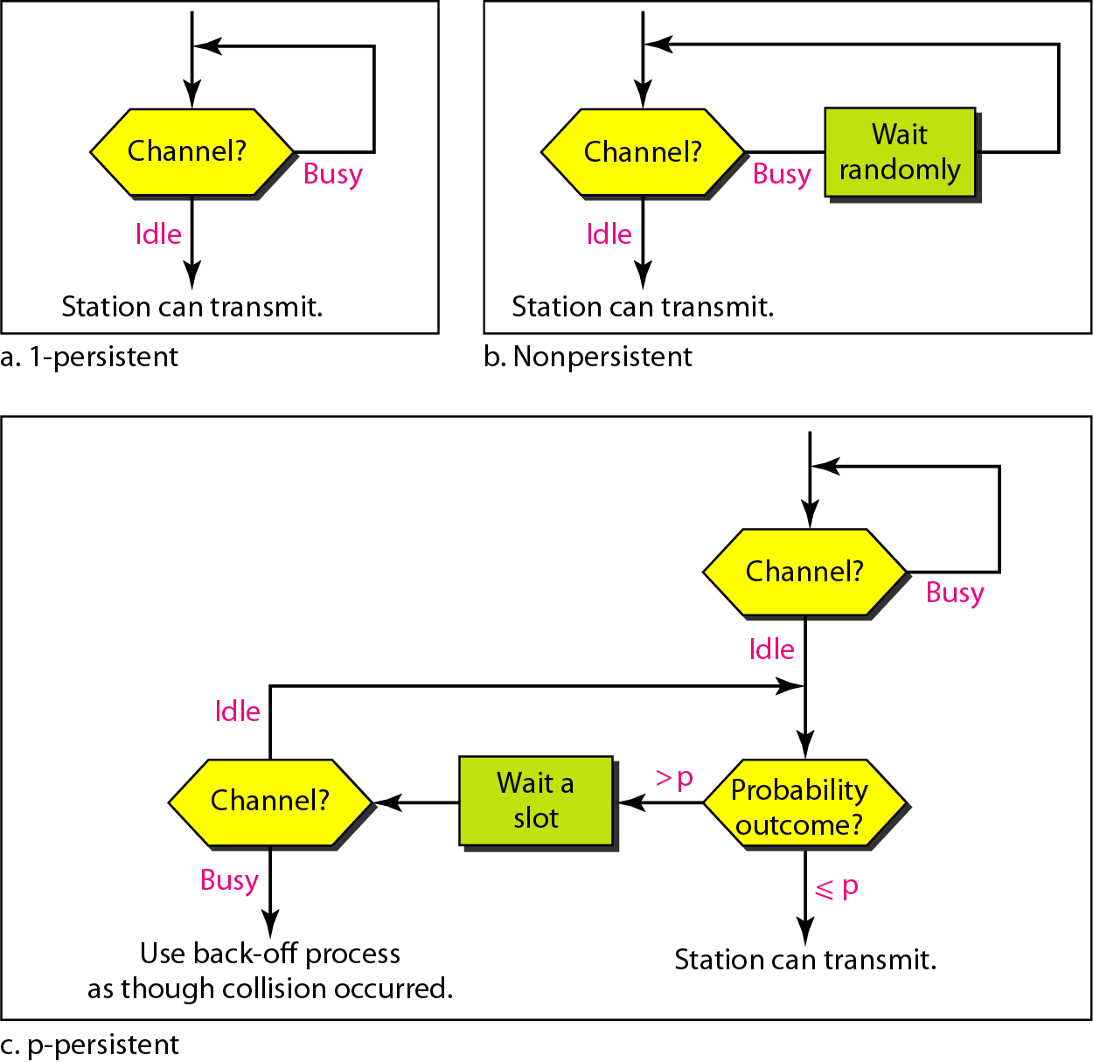
Flow diagram for three persistence methods

Slide 32
CSMA/CD (Collision Detection)
CSMA (all previous methods) has an inefficiency:
If a collision has occurred, the channel is unstable until colliding packets have been fully transmitted
CSMA/CD (Carrier Sense Multiple Access with Collision Detection) overcomes this as follows:
While transmitting, the sender is listening to medium for collisions.
Sender stops transmission if collision has occurred reducing channel wastage .
CSMA/CD is Widely used for bus topology LANs (IEEE 802.3, Ethernet).

Slide 33
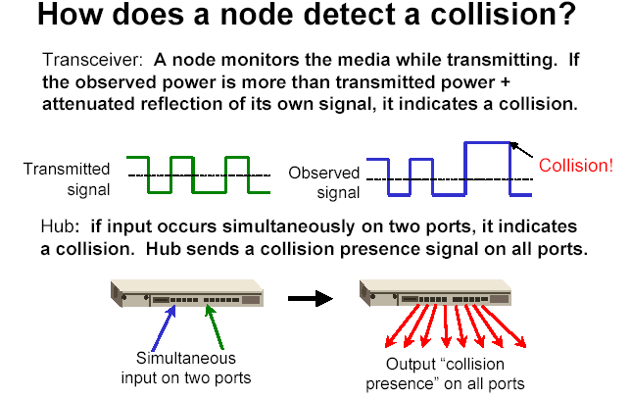
of its own
signal, it means collision occurred

Slide 34
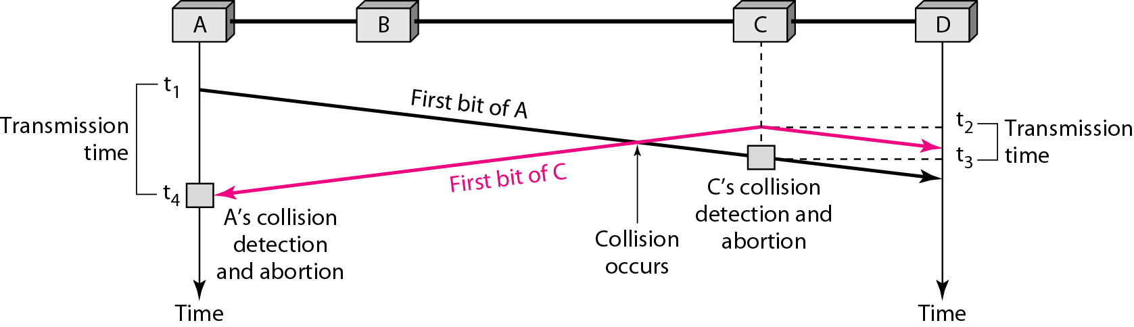
Collision of the first bit in CSMA/CD

Slide 35
CSMA/CD Protocol
Use one of the CSMA persistence algorithm
(non-persistent, 1-persistent, p-persistent) for transmission
If a collision is detected by a station during its transmission then it should do the following:
Abort transmission and
Transmit a jam signal (48 bit) to notify other stations of collision
After sending the jam signal, backoff (wait) for a random amount of time, then Transmit the frame again

Slide 36
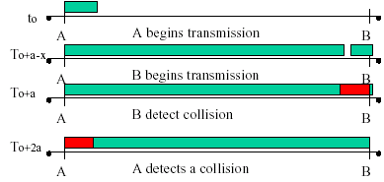
CSMA/CD
Question: How long does it take to detect a collision?
Answer: In the worst case, twice the maximum propagation delay of the medium
Note: a = maximum propagation delay

Slide 37
CSMA/CD
Restrictions of CSMA / CD:
Packet transmission time should be at least as long as the time needed to detect a collision (2 * maximum propagation delay + jam sequence transmission time)
Otherwise, CSMA/CD does not have an advantage over CSMA

Slide 38
Exponential Backoff Algorithm
Ethernet uses the exponential backoff algorithms to determine the best duration of the random waiting period after the collision happens
Algorithm:
Set “slot time” equal to 2*maximum propagation delay + Jam sequence transmission time (= 51.2 usec for Ethernet 10-Mbps LAN)
After K^{th} collision, select a random number (R) between 0 and
2^{k} –1 and wait for a period equal to (R*slot time) then retransmit when the medium is idle, for example:
After first collision (K=1), select a number (R) between 0 and 2¹ –1 {0 ,1} and wait for a period equal to R*slot times (Wait for a period 0 usec or 1x51.2 usec) then retransmit when the medium is idle
Do not increase random number range, if K=10
➔ Maximum interval {0 – 1023}
Give up after 16 unsuccessful attempts and report failure to higher layers

Slide 39
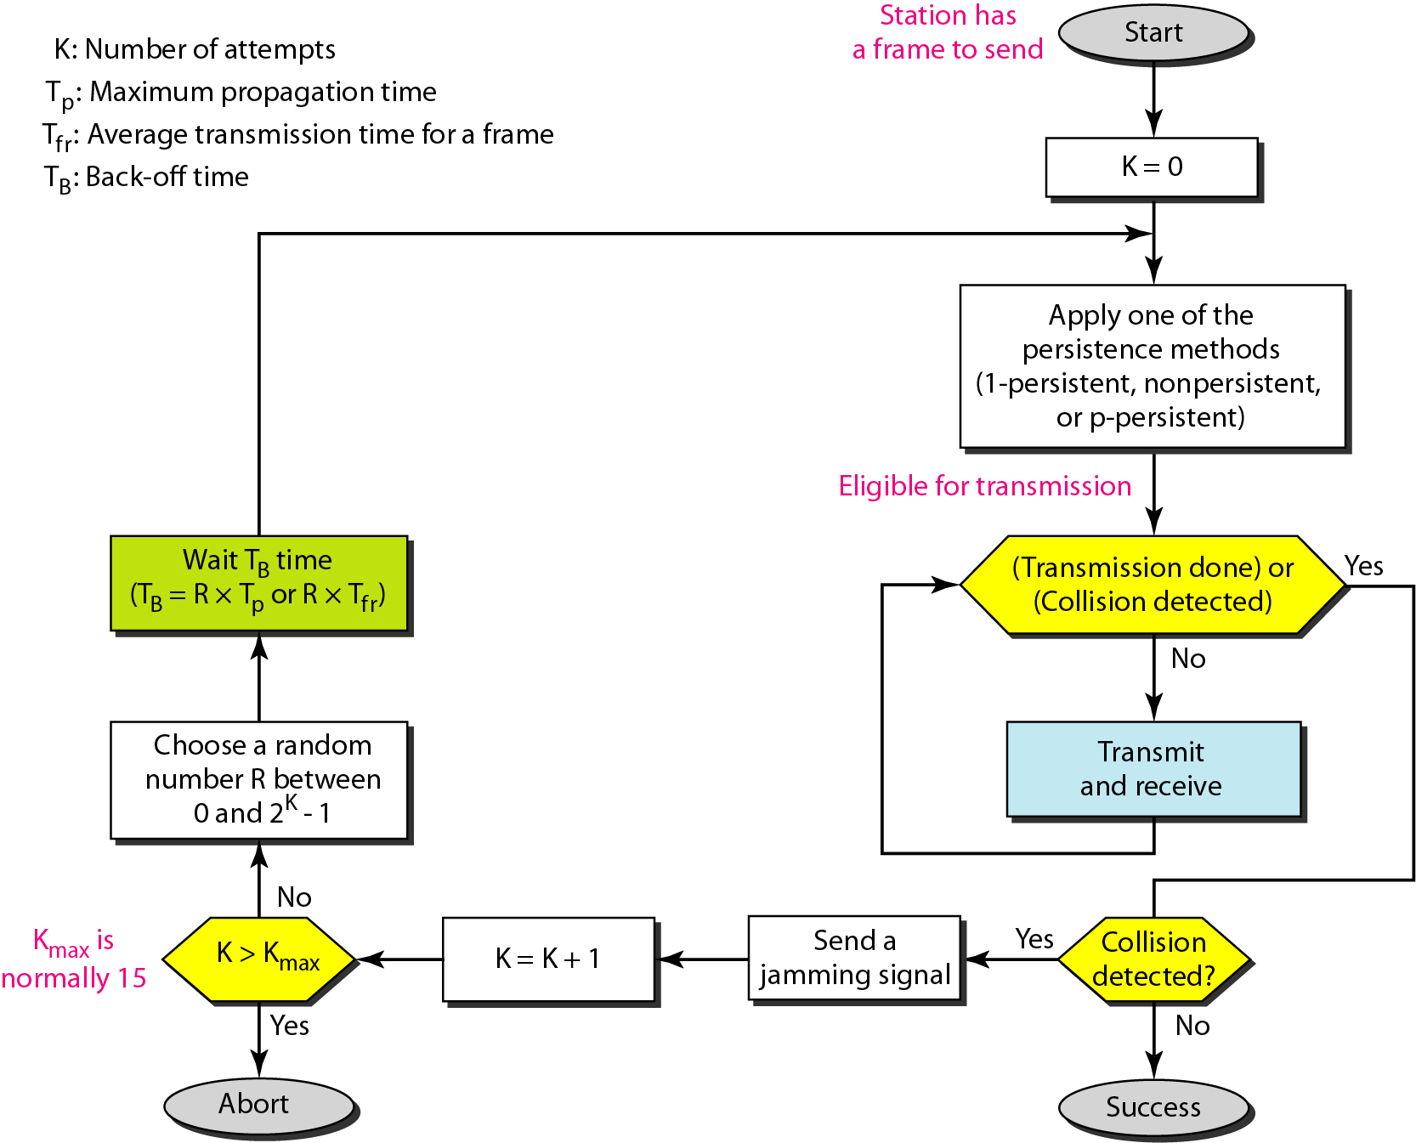
Flow diagram for the CSMA/CD
N=0
Wait R*slot time
Choose R between 0 & 2^{k} - 1
K=10
K=N
No
Yes
No
N < 10
N==16
N=N+1
Yes
Abort

Slide 40
Exponential Backoff Algorithm……
Reduces the chance of two waiting stations picking the same random waiting time
When network traffic is light, it results in minimum waiting time before transmission
As congestion increases ( traffic is high), collisions increase, stations backoff by larger amounts to reduce the probability of collision.
Exponential Back off algorithm gives last-in, first-out effect
Stations with no or few collisions will have the chance to transmit before stations that have waited longer because of their previous unsuccessful transmission attempts.

Slide 41
Performance of Random Access Protocols
Simple and easy to implement
Decentralized (no central device that can fail and bring down the entire system)
In low-traffic, packet transfer has low-delay
However, limited throughput and in heavier traffic, packet delay has no limit.
In some cases, a station may never have a chance to transfer its packet. (unfair protocol)
A node that has frames to be transmitted can transmit continuously at the full rate of channel (R) if it is the only node with frames
If (M) nodes want to transmit, many collisions can occur and the rate for each node will not be on average R/M

Slide 42
Ethernet – 802.3
History
Developed by Bob Metcalfe and others at Xerox PARC in mid-1970s
Standardized by Xerox, DEC, and Intel in 1978
LAN standards define MAC and physical layer connectivity
IEEE 802.3 (CSMA/CD - Ethernet) standard – originally 2Mbps
IEEE 802.3u standard for 100Mbps Ethernet
IEEE 802.3z standard for 1,000Mbps Ethernet
CSMA/CD: Ethernet’s Media Access Control (MAC) policy
CS = carrier sense
Send only if medium is idle
MA = multiple access
CD = collision detection
Stop sending immediately if collision is detected

Slide 43
Ethernet Addresses
End nodes are identified by their Ethernet Addresses (MAC Address or Hardware Address) which is a unique 6 Byte address.
MAC Address is represented in HexaDecimal format e.g 00:05:5D:FE:10:0A
The first 3 bytes identify a vendor (also called prefix) and the last 3 bytes are unique for every host or device

Slide 44
Ethernet
Name | Cable | Topology | Nodes/seg | Max segment length | speed
10Base5 (Thicknet) | Thick coax | Bus | 100 | 500 m with at most 4 repeaters | 10mbps
10Base2 (Thinnet) | Thin Coax | Bus | 30 | 185 m with at most 4 repeaters | 10mbps
10Base-T | Twisted pair UTP cat3/cat5 | Star | 1024 | 100 m with at most 4 hubs | 10mbps
10 Base-F | Multimode/sibglemode Fiber optic cable | Tree | 1024 | 2000m | 10mbps

Slide 45
Ethernet
The number 10: At the front of each identifier, 10 denotes the standard data transfer speed over these media - ten megabits per second (10Mbps).
The word Base: Short for Baseband, this part of the identifier signifies a type of network that uses only one carrier frequency for signaling and requires all network stations to share its use.
The segment type or segment length: This part of the identifier can be a digit or a letter:
· Digit - shorthand for how long (in meters) a cable segment may be before attenuation sets in. For example, a 10Base5 segment can be no more than 500 meters long.
Letter - identifies a specific physical type of cable.

Slide 46
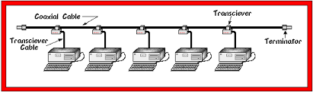
10Base5 Cabling
Uses Vampire Taps.
A pin is very carefully forced halfway into coaxial cable’s core.
Difficult to install.

Slide 47
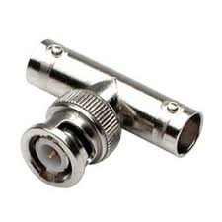
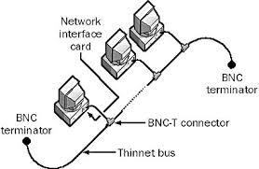
10Base2 Cabling
Uses BNC connectors.
Easier to use
More reliable
Thinnets are Easy to install
But can run only 185 meter/segment

Slide 48
10Base 2 and 10 base5
Disadvantages
Detecting cable breaks is difficult
Excessive length
Bad taps or loose connectors can be a problem.
Installation is difficult

Slide 49
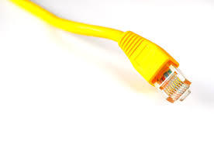
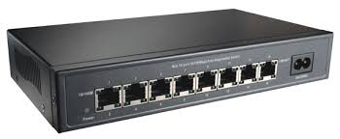
10BaseT cabling
UTP connectors (RJ -45 connectors)
Easy to install
Easy to maintain
Fault detection and
Fault isolation is easy
Hub with RJ-45 connectors

Slide 50
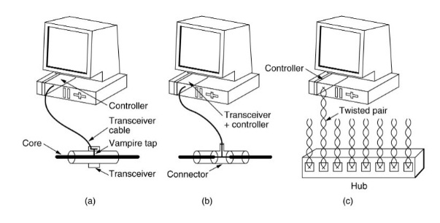
Cabling

Slide 51
10BaseF cabling
A fiber optic connector terminates the end of a fiber optic cable, and enables quicker connection and disconnection than splicing.
It has to be aligned properly to the microscopic glass fibers completely in order to allocate for communication.
In all, there are nearly 100 fiber optic connectors in the market, but only a few represents the majority of the market —
LC connector, SC connector, ST connector, FC connector etc.
Expensive due to the cost of connectors and terminators.
But excellent noise immunity

Slide 52
Fiber optic Connectors
SC - Subscriber Connector
LC - Lucent Connector
FC - Ferrule Connector
ST - Straight Tip

Slide 53
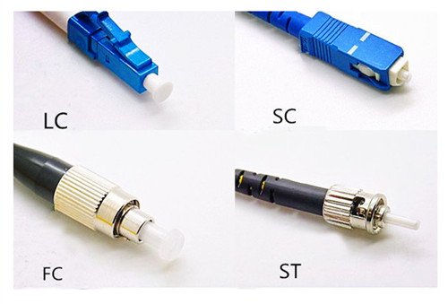
Fiber optic Connectors

Slide 54
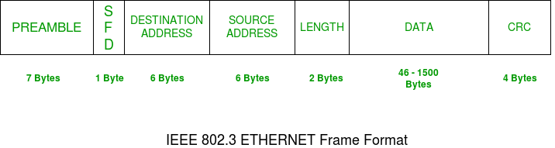
IEEE 802.3 (Ethernet) Frame format

Slide 55
IEEE 802.3 (Ethernet) Frame format
PREAMBLE – Ethernet frame starts with 7-Bytes Preamble. This is pattern of alternative 0’s and 1’s which indicates starting of the frame and allow sender and receiver to establish bit synchronization.
Start of frame delimiter (SFD) – This is a 1-Byte field which is always set to 10101011. SFD indicates that upcoming bits are starting of frame, which is destination address.

Slide 56
Destination Address – This is 6-Byte field which contains the MAC address of machine for which data is destined.
Source Address – This is a 6-Byte field which contains the MAC address of source machine.

Slide 57
Length – Length is a 2-Byte field, which indicates the length of entire Ethernet frame. This 16-bit field can hold the length value between 0 to 65534, but length can not be larger than 1500 because of some own limitations of Ethernet.
Data – This is the place where actual data is inserted, also known as Payload. Both IP header and data will be inserted here, if Internet Protocol is used over Ethernet. The maximum data present may be as long as 1500 Bytes. In case data length is less than minimum length i.e. 46 bytes, then padding 0’s is added to meet the minimum possible length.
Cyclic Redundancy Check (CRC) – CRC is 4 Byte field. This field contains 32-bits hash code of data, which is generated over Destination Address, Source Address, Length and Data field. If the checksum computed by destination is not same as sent checksum value, data received is corrupted.

Slide 58
Fast Ethernet
100 Mbps bandwidth
Uses same CSMA/CD media access protocol and packet format as in Ethernet.
100BaseTX (UTP) and 100BaseFX (Fiber) standards
Physical media :-
100 BaseTX - UTP Cat 5e
100 BaseFX - Multimode / Singlemode Fiber
Full Duplex/Half Duplex operations.

Slide 59
Fast Ethernet
Maximum Segment Length
100 Base TX - 100 m
100 Base FX - 2 Km (Multimode Fiber)
100 Base FX - 20 km (Singlemode Fiber)

Slide 60
Gigabit Ethernet
1 Gbps bandwidth.
Uses same CSMA/CD media access protocol as in Ethernet and is backward compatible (10/100/100 modules are available).
1000BaseT (UTP), 1000BaseSX (Multimode Fiber) and 1000BaseLX (Multimode/Singlemode Fiber) standards.
Maximum Segment Length
1000 Base T - 100m (Cat 5e/6)
1000 Base SX - 275 m (Multimode Fiber)
1000 Base LX - 512 m (Multimode Fiber)
1000 Base LX - 20 Km (Singlemode Fiber)
1000 Base LH - 80 Km (Singlemode Fiber)

Slide 61
10 Gig Ethernet
10 Gbps bandwidth.
Uses same CSMA/CD media access protocol as in Ethernet.
Propositioned for Metro-Ethernet
Maximum Segment Length
1000 Base-T - Not available
10GBase-LR - 10 Km (Singlemode Fiber)
10GBase-ER - 40 Km (Singlemode Fiber)

Slide 62
End of MAC

Slide 63
Lets take a Quiz
1. The data link layer takes the packets from _________ and encapsulates them into frames for transmission. a) network layer b) physical layer c) transport layer d) application layer
2. Which one of the following task is not done by data link layer? a) framing b) error control c) flow control d) channel coding

Slide 64
3. Which sublayer of the data link layer performs data link functions that depend upon the type of medium? a) logical link control sublayer b) media access control sublayer c) network interface control sublayer d) none of the mentioned
4. Header of a frame generally contains a) synchronization bytes b) addresses c) frame identifier d) all of the mentioned

Slide 65
5. Automatic repeat request error management mechanism is provided by a) logical link control sublayer b) media access control sublayer c) network interface control sublayer d) none of the mentioned
6. Which one of the following is a data link protocol? a) ethernet b) point to point protocol c) hdlc d) all of the mentioned
7. The technique of temporarily delaying outgoing acknowledgements so that they can be hooked onto the next outgoing data frame is called a) piggybacking b) cyclic redundancy check c) fletcher’s checksum d) none of the mentioned

Slide 66
8. When does the station B send a positive acknowledgement (ACK) to station A in Stop and Wait protocol? a. only when no error occurs at the transmission level b. when retransmission of old packet in a novel frame is necessary c. only when station B receives frame with errors d. all of the above
9.Which provision can resolve / overcome the shortcomings associated with duplication or failure condition of Stop and Wait Automatic Repeat Request protocol especially due to loss of data frames or non-reception of acknowledgement? a. Provision of sequence number in the header of message b. Provision of checksum computation c. Both a & b d. None of the above

Slide 67
What are the frames issued by the secondary station of HDLC ,known as? a. Link b. Command c. Response d. None of the above

